Slide 1

RFID Backscattering in Long-Range Scenarios
Francesco Amato, Member, IEEE, Hakki M. Torun, Student Member, IEEE, and Gregory D. Durgin, Member, IEEE.
Ruthwik H Param
1DS16CS125
Department of Computer Science & Engineering, DSCE

Slide 2
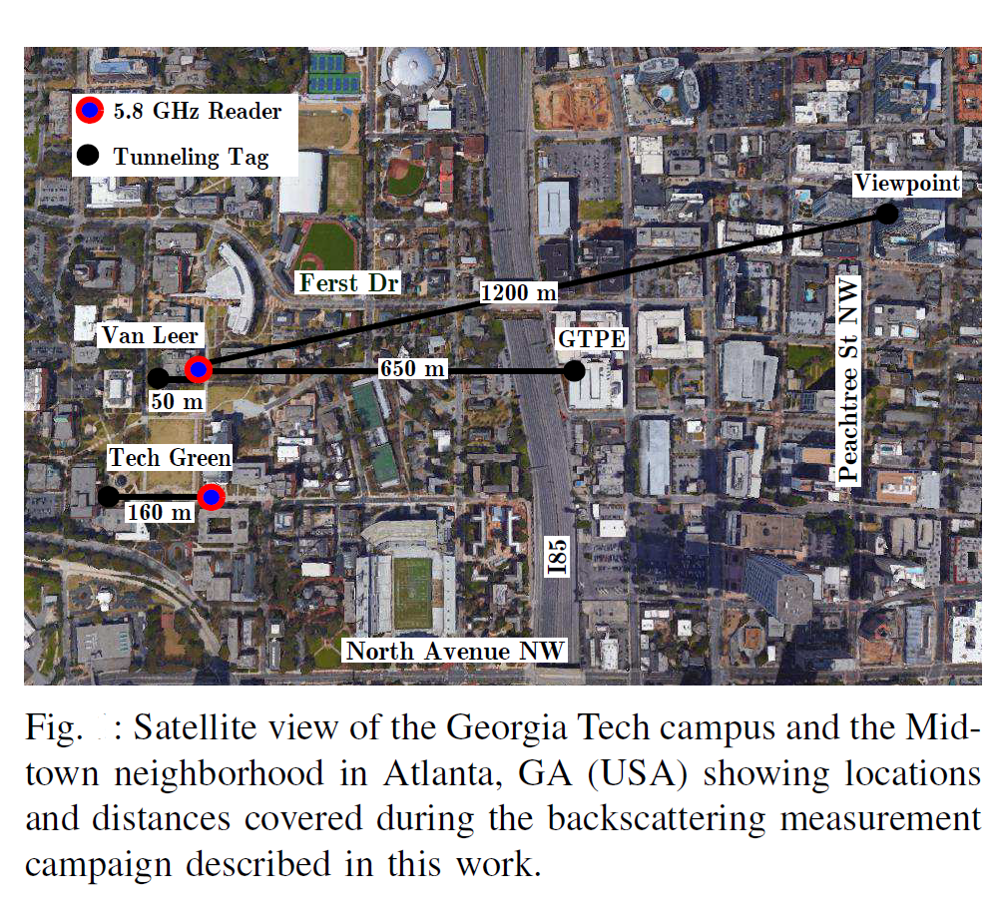
Introduction
RFID is an acronym for radio-frequency identification and refers to a technology whereby digital data encoded in RFID tags or smart labels are captured by a reader via radio waves.
Backscattering (or backscatter) is the reflection of waves, particles, or signals back to the direction they came from. Backscattering is defined also as the phenomenon that occurs when radiation or particles are scattered at angles to the original direction of motion of greater than 90°.

Slide 3
The Internet of things (IoT) is a system of interrelated computing devices, mechanical and digital machines are provided with unique identifiers and the ability to transfer data over a network without requiring human-to-human or human-to-computer interaction.
By the end of 2020, it is speculated that 210 billion of connected Internet-of-Things devices will be connected that will utilize wireless technology to be able to communicate with each other and to human users as well.
One of the main concerns of the IoT devices connected across the world is energy consumption and the demand for constant battery replacement which are the major drawbacks of using IoT devices.

Slide 4
Literature Survey
Shao, Shuai, et al. “Broadband Textile-Based Passive UHF RFID Tag Antenna for Elastic Material.” IEEE Antennas and Wireless Propagation Letters, vol. 14, 2015.
Scherhaufl, Martin, et al. “UHF RFID Localization Based on Evaluation of Backscattered Tag Signals.” IEEE Transactions on Instrumentation and Measurement, vol. 64, no. 11, 2015.
Scherhaufl, Martin, et al. “Robust Localization of Passive UHF RFID Tag Arrays Based on Phase-Difference-of-Arrival Evaluation.” 2015 IEEE Topical Conference on Wireless Sensors and Sensor Networks (WiSNet), 2015.

Slide 5
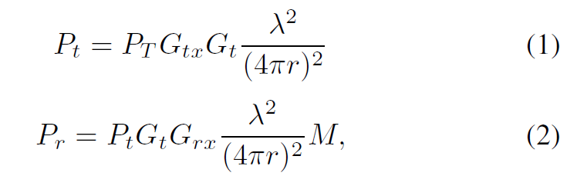
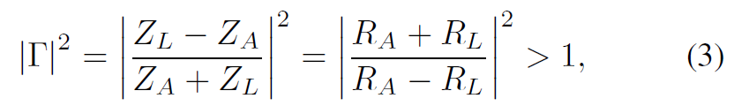

Rationale

Slide 6
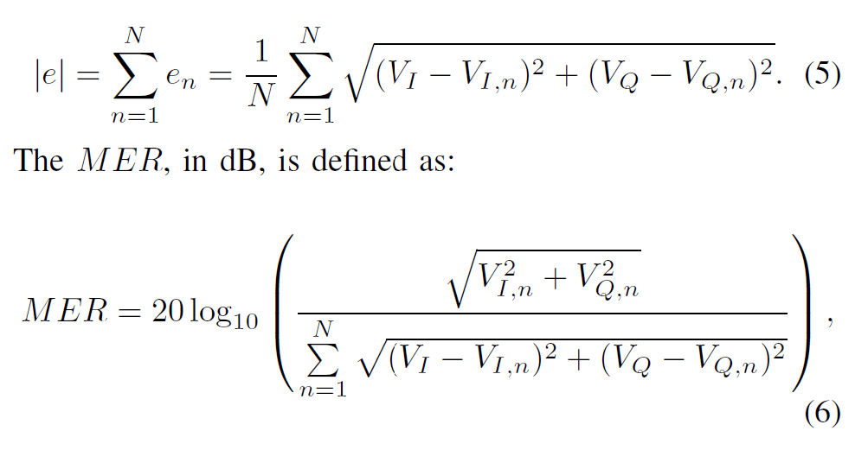
Rationale (continued)

Slide 7
The Experiment Setup
(The data used in this section has been procured from the paper that is being referred to.)
The researchers of this paper have divided the experiment into four sections. The Microwave Reader, the Tunneling Tag, Instrument Calibration, and the Field Test Campaign.
The Microwave Reader
Its transmitting section generates a 5.8 GHz CW of power P_{T} and it is connected to an output antenna with gain G_{tx}. Its receiving section has a high-pass cut-off frequency of 20 kHz and a low-pass cutoff of 2 MHz.
2. The Tunneling Tag
The 5.8 GHz Tunneling Tag consists of a TR connected to a tag antenna of gain G_{t} and a waveform generator that modulates, amplifies and backscatters the impinging CW through a biasing square wave of tunable voltage amplitude V_{pp} and frequency f_{m}.

Slide 8
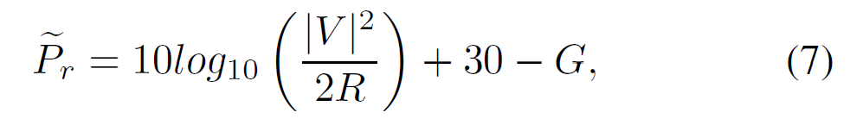
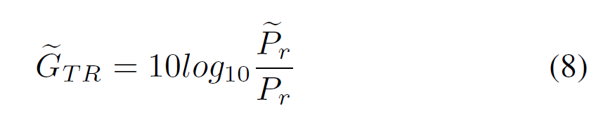
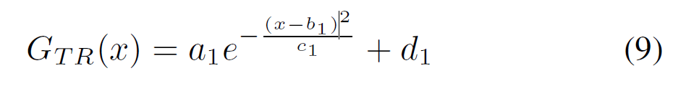
The Experiment Setup
3. Instrument Calibration
Since V = V_{I} + jV_{Q} corresponds to the average voltage measured at the I and Q output ports of the microwave reader, a calibration procedure was necessary to identify the offset correction G (in dB) that needs to be taken out for measuring the correct amount of power P_{r} at the receiving antenna terminals:
4. The Field Test Campaign
Tests were conducted by varying the distances r between the reader and the Tunneling Tag. For each distance, different bias voltages V_{pp} were applied for two or more modulation speeds fm.

Slide 9
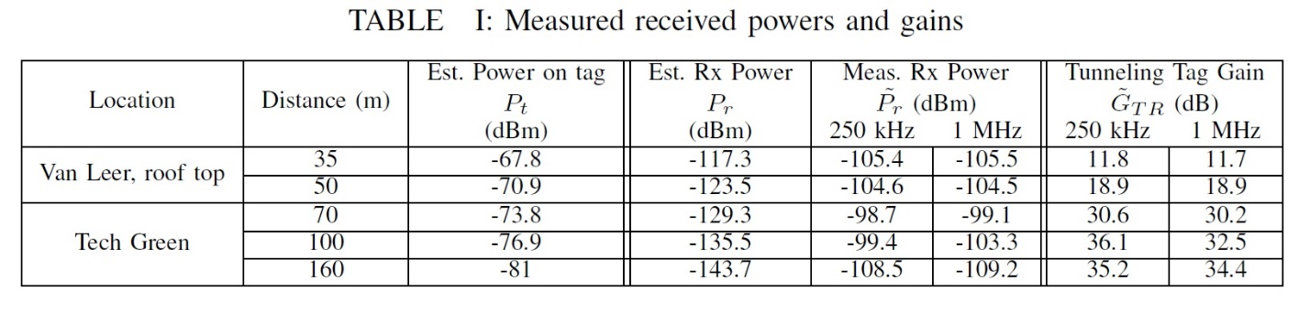
The table above shows a part of the end results that the authors of the paper have procured through the field tests and measurement test campaign. It depicts for two of the chosen locations, Van Leer, roof top, and Tech Green, with the various distances used as a controlling agent in the experiment.

Slide 10
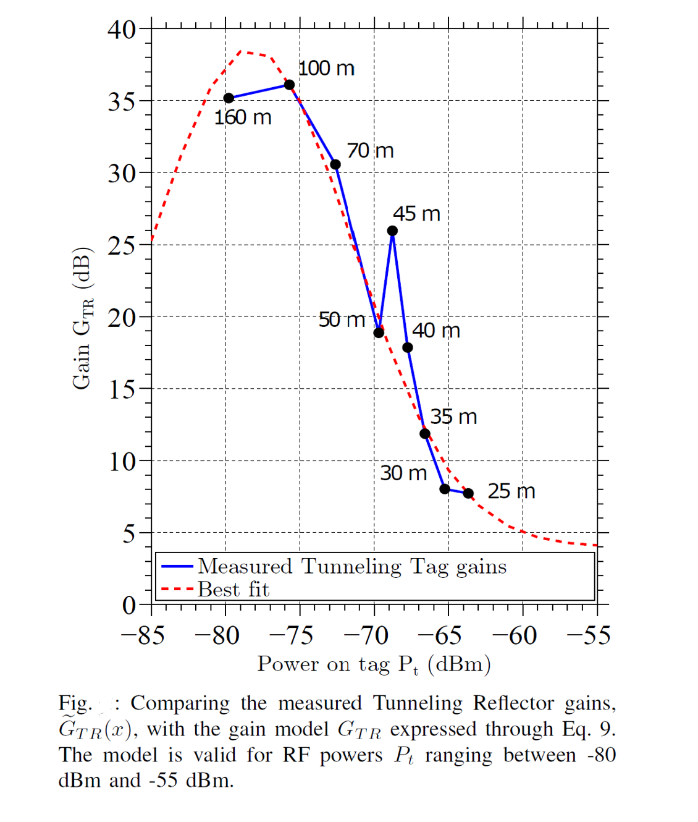

Slide 11
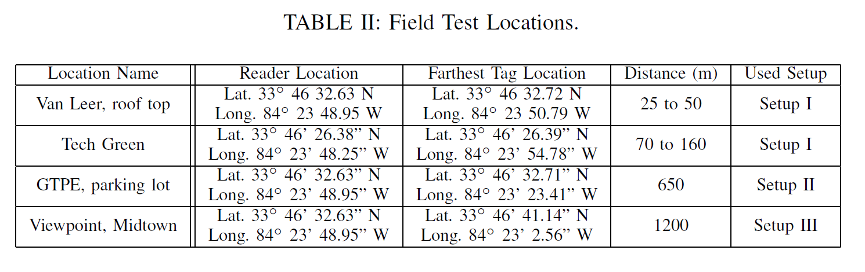
Achieved Ranges and Gains of the Tunneling Tag
The measurement campaign aimed to experimentally verify the capabilities of a Tunneling Tag in terms of achievable ranges and gains. Table II show and summarize the measurements done for this work.

Slide 12
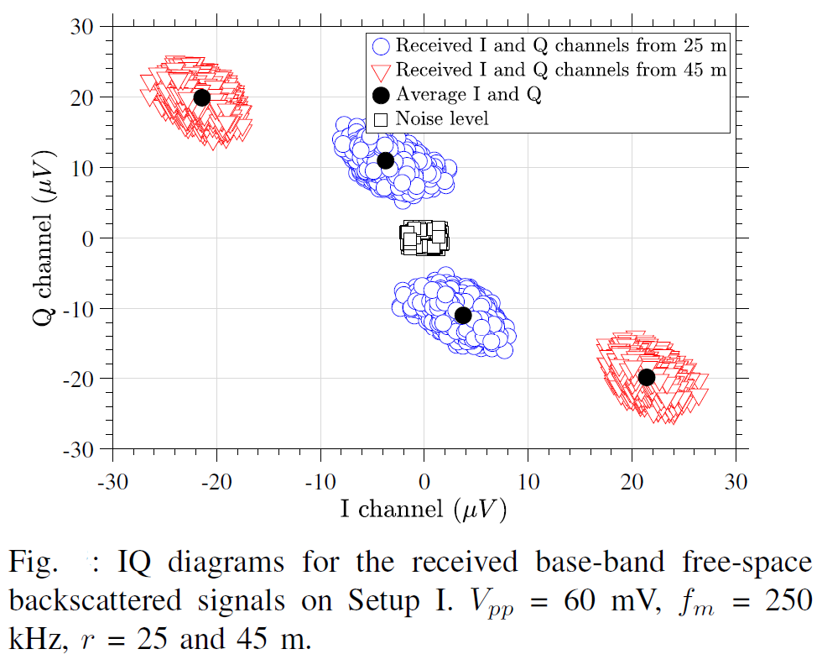
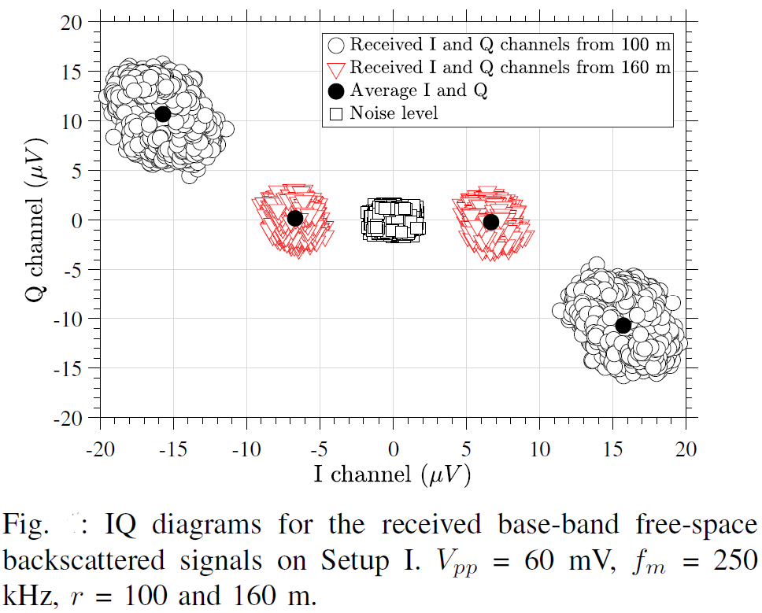

Slide 13
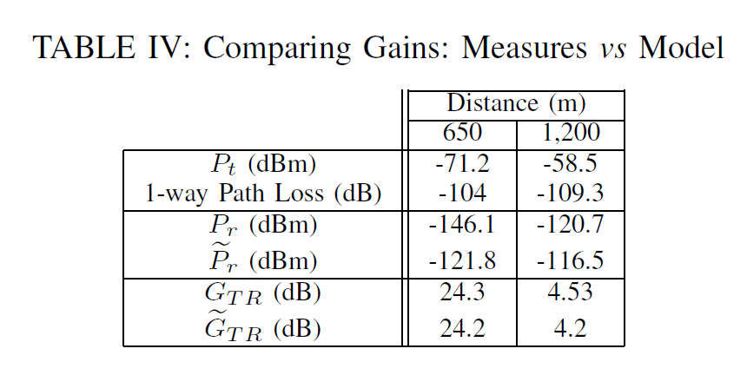
Gain Model Validation and Modulation Errors
(The data used in this section has been procured from the paper that is being referred to.)
To test the accuracy of the mathematical model (Eq. 9) in predicting the TR gains G_{TR}, backscattering tests were held with the Tunneling Tag placed at 650 m and 1.2 km away from the reader. A summary of the results in shown in Table IV.

Slide 14
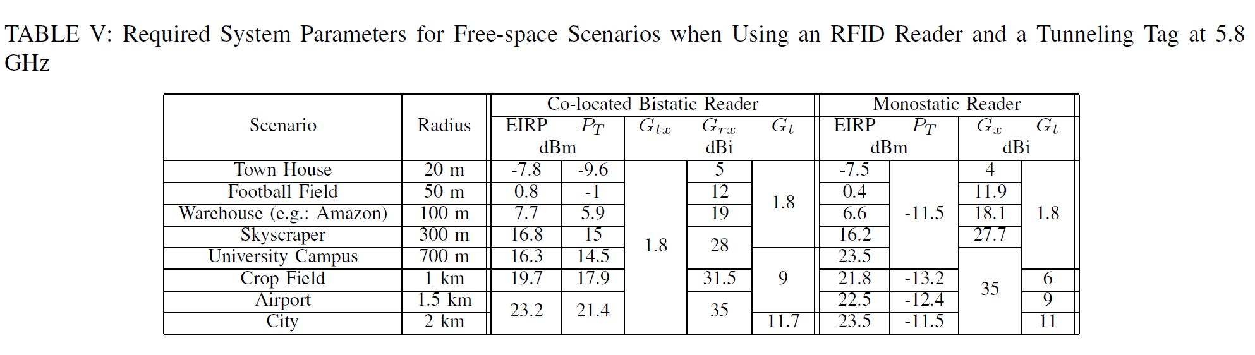
Link Budget Designer Tool
Testing Scenarios
Long Range Backscattering

Slide 15
Considerations on Power Consumption
The Tunneling Tag that was showcased here has a requirement of a certain biasing power to work in the manner it is supposed to.
This requirement does not allow to identify the prototype as a passive transponder; nevertheless the consumed power is extremely low when compared to any other state-of-the-art RF wireless devices.
This amount of biasing power, although very low, is enough to amplify very weak impinging RF signals whose amplitude is below -40 dBm.
Thanks to the high sensitivity of the device, low impinging RF powers are enough to obtain backscattering modulation and amplification. The low powers required by the Tunneling Tag prototype contribute, from both an economically and environmentally point of view, to a future with billions of wireless devices.

Slide 16
Conclusion
The authors have constructed a system in which a reader, and a low powered Tunneling Tag which is capable of communicating at a very long range using backscattering communications at 5.8 GHz.
Using the designed tool, the future generation will be able to further advance in this field and will be able to create better solutions to existing problems as well be able to create more efficient solutions.
By understanding the results, we can see that by reducing power requirements while granting considerable communication distances, and we can understand that the Tunneling Tag will help provide a bright future for wireless IoT devices and backscattering applications.
Tunneling Tags with the use of backscattering communication will allow for RFID tags in general as well as become more efficient towards energy consumption which in turn will allow for greater utilization and yield better results in the long run as well as for immediate use.

Slide 17
References
^{[1]} Shao, Shuai, et al. “Broadband Textile-Based Passive UHF RFID Tag Antenna for Elastic Material.” IEEE Antennas and Wireless Propagation Letters, vol. 14, 2015.
^{[2]} Scherhaufl, Martin, et al. “UHF RFID Localization Based on Evaluation of Backscattered Tag Signals.” IEEE Transactions on Instrumentation and Measurement, vol. 64, no. 11, 2015.
^{[3]} Scherhaufl, Martin, et al. “Robust Localization of Passive UHF RFID Tag Arrays Based on Phase-Difference-of-Arrival Evaluation.” 2015 IEEE Topical Conference on Wireless Sensors and Sensor Networks (WiSNet), 2015.
^{[4]} ATMEL. (Accessed Jan. 2018) Samb11. [Online]. Available: http: //www.atmel.com/Images/Atmel-42426-SmartConnect-SAMB11-SOC Datasheet.pdf
^{[5]} Empire State Realty Trust, “Empire State building fact sheet,” Accessed Jan., 2018. [Online]. Available: http://www.esbnyc.com/sites/default/files/esb fact sheet 4 9 14 4.pdf
^{[6]} C. He, Z. J. Wang, C. Miao, and V. C. M. Leung, “Block-level unitary query: Enabling orthogonal-like space-time code with query diversity for MIMO backscatter RFID,” IEEE Transactions on Wireless Communications, vol. 15, no. 3, pp. 1937–1949, March 2016.
^{[7]} C. Boyer and S. Roy, “Invited paper - backscatter communication and RFID: Coding, energy, and MIMO analysis,” IEEE Transactions on Communications, vol. 62, no. 3, pp. 770–785, March 2014.
^{[8]} S. Grebien, J. Kulmer, F. Galler, M. Goller, E. Leitinger, H. Arthaber, and K. Witrisal, “Range estimation and performance limits for UHF-RFID backscatter channels,” IEEE Journal of Radio Frequency Identification, vol. PP, no. 99, pp. 1–1, 2017.

